Slide 1
A Personal Story…
Notes:
Thank you helene
Honoured to be here speaking in front of the best headhunters in the world
All the more honoured that i am going to talk about ME; something totally different than usually
Usually talking about marketing in the digital age, today it is about ME in the digital age
Two of my favourite topics…
A few months back…Met Helene
Told her about my sabbatical year with my family as of July 2011
Asked me to come here and tell my story
Did not understand first why strangers would be interested in my sabbatical year.
But, never let pass the occasion to speak to the best headhunters…you never know…

Slide 2
…a Self Reinvention
in the Digital Age
Notes:
Started to think of why she invited me
I realized it is about reinventing myself
A reinvention that is totally embedded in the digital age
And that could inspire others

Slide 3
Whuffie: virtual currency that measures
the ‘Social Capital’ of an individual or an organization
Notes:
First an anecdoct that happened to me a year ago
That introduces some key elements of the story
Mother-in-law call in the middle of a romantic dinner with my wife
Facebook: post about a book by a facebook friend
Interesting
The Whuffie effect
Whuffie explanation
My social capital has always been something very important for me
Leveraging the Social capital is a key element of my presentation today

Slide 4
Serendipity: when someone finds something or somebody
he was not expected to find. A Happy Accident
Notes:
Another element is serendipity
See the book on the table, meet the group, buy the book

Slide 5
Notes:
This is how I became the first french buyer of the book
And i have the only one which is signed by the whole team
Social networks, serendipity, social capital

Slide 6
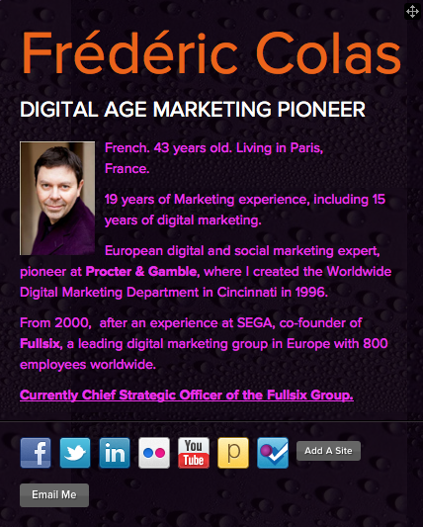
The Old ‘ME’ www.about.me/ fredcolas
Notes:
Let’s move to the story
This is the old me
My CV: Digital marketing pioneer: P&G, Sega, Fullsix

Slide 7
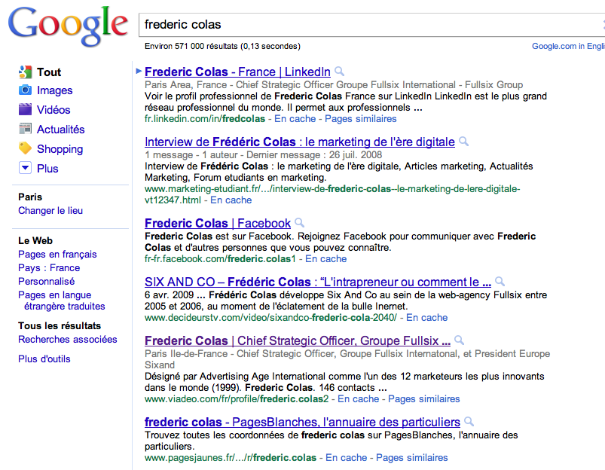
The Old ‘ME’ www.google.com
Notes:
Go to google: you find the same old me
Interviews about digital age marketing, fullsix…

Slide 8
Need For
Personal and Professional
Reinvention
A New ME ?
Notes:
For personal reasons and for age reasons (joke about mid-life crisis), needed to do something new
But not just ‘do’, why not trying to ‘be’ new
Reinventing myself

Slide 9
Notes:
July 2010: went on vacations in Costa Rica
This is my rebirth place, the house
Nice house on the beach
Great place to get inspired

Slide 10
Notes:
This is why it is a great place to get inspired
This is where I started to think of the ‘new me’

Slide 11
A New ‘ME’ ?
Notes:
And the ‘new me’ eventually came
with a project called: We Like The World

Slide 12
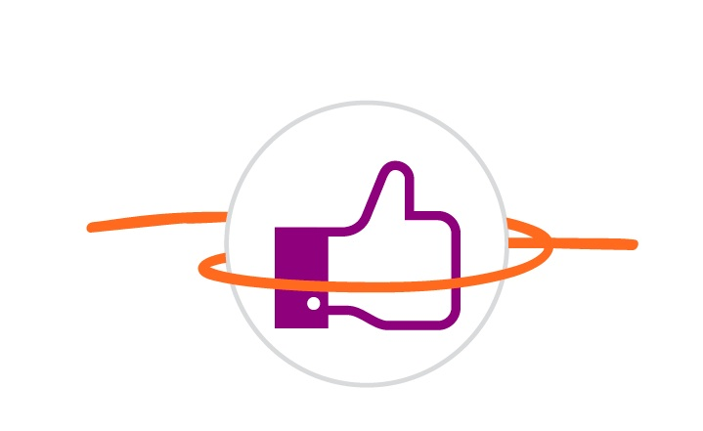
Around the World with 80,000 friends
Notes:
What is we like the world? a family trip around the world

Slide 13
A Trip Around The World from July 2011 to June 2012
Air
Land
Turkey
May 2012
North America
June-Sept. 2011
Asia
Jan-Feb 2012
Burkina Faso
June 2012
India
March-April 2012
Oceania
Nov. 2011
Australia
Dec 2011
South America
Sept-Oct. 2011
Notes:
Leaving in less than a month, all around the world,
But not ANY trip around the world
I would not leave without A CONCEPT
And this concept had to have 3 ingredients:
INNOVATIVE (linked to social networks)
ENJOYABLE
USEFUL (for us and others)

Slide 14
The First Trip Around the World Co-designed and Powered by a Social Graph
From Jules Verne and 80 days…
Industrial Revolution
Bringing Places closer to one another
…to Facebook and 80,000 friends
Social Networks Revolution
Bringing people closer to one another
Notes:
Innovative
Jules Verne’s story

Slide 15
The Video Clip: ‘We Like the World’
Notes:
Enjoyable: time of our lives as the song says
Let’s see a video explaining what we are doing.
This video was originally conceived as a seasonal greeting video for our friends,
It became the SOCIAL OBJECT THAT MADE OUR PROJECT BECOME REMARKABLE in the social networks
And I do not hesitate to be ridiculous in order to be rmarkable
Because We need help

Slide 16
The School Project
Build a primary school with 235 children in Cissé Yargo, Burkina Faso
Allow kids’ schooling, especially programs for girls, to enable them to write a brighter future
Notes:
Useful: school
Need 100 000 €, our family will give 40 000
Need 60 000+ coming from the people and sponsors…

Slide 17
Why Embrace the Girls Education Cause?
Because…
« Opening the doors of education to girls and women is not only the right thing to do, it is the smart one. »
Hillary Clinton Discours de l’UNESCO May 2011
It builds the economy
1% increase in girls education generates 0.3% economic growth Every additional year of education increases income by 20%.
It saves lives
Children of women who received 5 years of primary education have 40% less chances to die before the age of 5.
It benefits to the Society as a whole
They better educate their own children later, girls and boys.
Notes:
Girls education: mkes sense for both personal and professional reasons

Slide 18
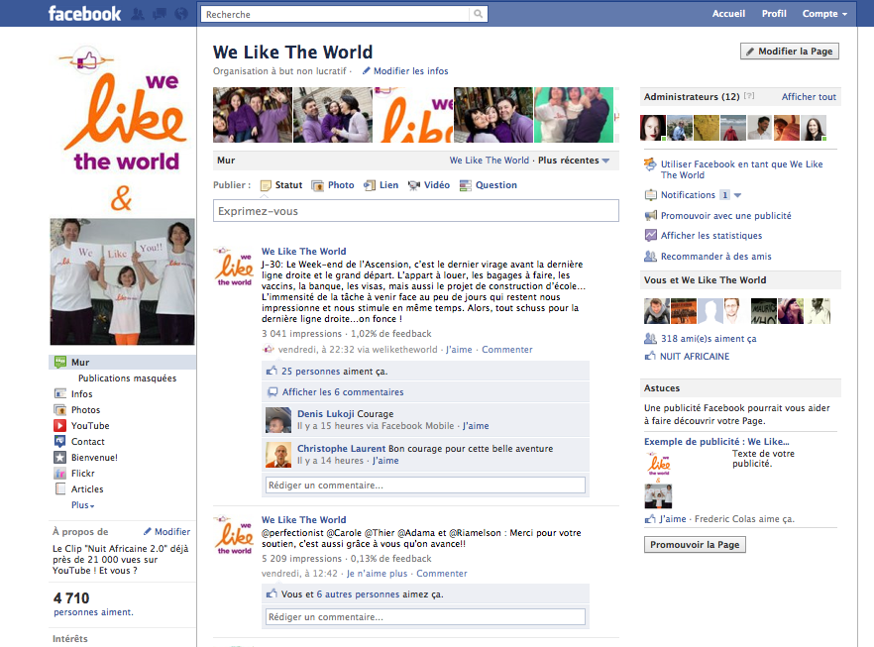
Facebook Page: 4710 Fans
Notes:
Our hub: no marketing yet
But we gather friends to build a strong enough network to find hosting everywhere in the world

Slide 19
Four Action Principles
Apply To Myself What I Advise My Clients
Exclusively Leverage My Network
Stay Open-Minded And Strive With The Unexpected
Nothing Is Too Big
Notes:
We have defined 4 actions principles because what we want to prove on this project is THE POWER OF THE NETWORK,
specifically friends of friends,
and that this power is multiplied by SOCIAL NETWORKS

Slide 20
The Partners of WLTW
Facebook, Official Partner
Facebook Worldwide chose to support WLTW
and will promote the project within its official global pages
and will offer free advertising space
Notes:
Quickly got attention from Facebook in Palo Alto who is officially supporting us

Slide 21
The Partners of WLTW
Notes:
And have other sponsors who help us achieve our challenge and/or support our school through donations

Slide 22
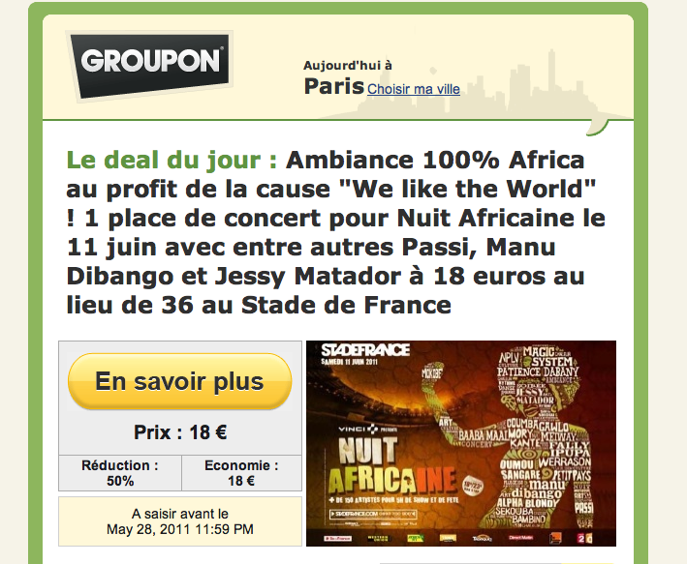
Stade de France: the Concert
Notes:
Stade de France: an example of of how serendipity, social capital and power of social networks come together
We end up to be the main cause supported by a concert in the Stade de France in front of 60000 people next Saturday
Nothing is too big…
Let’s see

Slide 23
The Vision of WLTW
Anyone who has Passion and Energy
Can, Now Better Than Ever,
Start a Movement Gathering Like-Minded People
And Make the World Better
By Effectively Leveraging Social Networks
Notes:
I now have a team of about 20 volunteers to move WLTW to the next level: benefiting to lots of other people who have great projects and energy but do not know how to leverage social networks

Slide 24
The Mission of WLTW
Making ‘Social’ Social
Social Networks Driving Social Progress
We Help the Non-Profit Projects
From the Civil Society
To Make a World We Like More
By Better Leveraging Social Networks
Notes:
In a nutshell: WLTW has a higher purpose :’ Making Social Social’and our trip is the pilot project

Slide 25
The 8 Key Success Factors of Non-Profit Projects
An Inspiring Project
Passion and Energy of the Project Leaders
Listening and Empowerment Attitude Towards Others
A Powerful Network
A Good Reputation
Flexible Organization
Remarkable Social Objects
Personal Social Media Mastery by the Project Leaders
Notes:
Concretely: we identified 8 key success factors and this is where WLTW can help other projects

Slide 26
An exclusive project led by Frédéric Colas
with the support of the World Federation of Advertisers
Notes:
THE CMO WT, here is the brand new logo. Take a picture of it and you will go directly to the blog

Slide 27
The Video: CMO World Tour
Notes:
CMO WT is about doing about 30 interviews all around the world, understanding CMOs, their attitudes towards the digital age, the impact on their personal lives and business actions, and in some way understanding the CMO of the digital age: not what they should be in the future, what they should be TODAY
This is a short initial iphone video explaining the concept

Slide 28
The CMO World Tour Eco-System
Connections
Status
Exposure
Creativity
Exposure
Peer Insights
Free Valuable
Content
CMOs
Content
Status
Exposure
Status
Money
Status
Insights
Notes:
Issue: besides my idea, i had nothing. And I did not want to invest money on it. Money should go to the school. But I had WHUFFIE
The eco-system of the project is only powered by Whuffie and finding WIN-WIN situation. Like a good food recipe, the secret is to find the proportions and the right order in which to put the ingredients
Details of the recipee
What do I get out of it: not money, but more social capital: network, media exposure and unique competences

Slide 29
The CMO World Tour Guest List
Already interviewed
Scheduled
Liu Chuanzi, Chairman Lenovo
Chris Burggraeve, CMO, AB InBev
Johan Jervoe, VP Marketing Sales Global, Intel
Joao Ciaco, VP Marketing Latin America, Fiat
Julia Goldin, CMO Revlon
Jon Wilkins, Founder Naked Comms
Philip Manzi, Director GMO, Nokia
Keith Weed, CMO Unilever
Martin Riley, CMO, Pernod-Ricard
Marco Tinelli, CEO, Fullsix
Pierre Woreczek, VP Strategy and Marketing Europe, McDonald’s
Sheryl Sandberg or David Fischer, Facebook
Federico Gonzalez, SVP Marketing, Disneyland Paris
Jim Stengel, former CMO P&G
Olivier Faujour, VP Europe, General Mills
Notes:
And it works, so fat about 90% accpetance of the CMOs we contacted
These are the ones I will do before leaving for the World Tour. Will be completed by interviews in Canada, the US, Brazil, Australia, China, India AND TURKEY

Slide 30
Some Early Learnings
Serendipity Is Not Coincidence…
It Is Providence…
That you can greatly Influence!
Notes:
My learnings of all this…
I have plenty of story of accidentally meeting the right people, but not just the right people, the right people at the right time !
And this is not luck.
Actually you can make it happen, by surfing on the unexpected and being open minded

Slide 31
Some Early Learnings
Network + Reputation =
Social Capital i.e Power in the Digital Age
New Skills for Leaders of the Digital Age
Notes:
Social networks give more power to the socially gifted individuals,
the ones who know how to mobilize a network,
those who have a high Social capital, those that other people want to help,
not just because this is their own interest but just because they like them and want them to succeed.
Ok, this is not Mickey Mouse land either but still…
Why: because by cutting down the efforts and cost for interactions, the effort needed to help others goes down.
If you want to share my project with a lot of your friends my project, just a click on facebook will make it.
Before , you would need to call friends one-by-one, and despite your goodwill, you would not do it.
Whether you liked me or not, the end result was very close.
Now, If you like me or what I am doing, you will tell your friends, who will pass it also…
There is a project I found last week-end: it is called 10/3: how to build a school in Africa in 3 hours? Not possible before

Slide 32
The New ‘ME’ www.about.me/fredcolas
Notes:
The new me is not very different when it comes to the CV: I am still CSO of F6. But what is different is not seen, it is in my head and in my heart

Slide 33
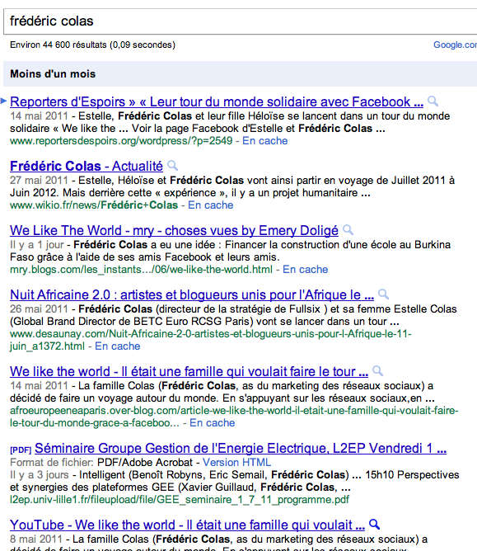
The New ‘ME’ www.google.com
Notes:
But Google sees it

Slide 34
The Next ME ?
Notes:
Next ME? In one year, no clue
I will be further transformed by this year off

Slide 35
If you want to co-create the next ME…
Donate for the School
Host Us
Call me: +33 613 09 03 26

Slide 36
WE like YOU
facebook.com/weliketheworld
weliketheworld.com

